Slide 1

Disturbance Observer Based Control Design for Wind Turbine Speed Regulation
Yuan Yuan, Xu Chen, and Jiong Tang
Oct 12, 2016
ASME Dynamic Systems and Control Conference 2016
Department of Mechanical Engineering
University of Connecticut
Storrs, CT, USA
Structure and System Dynamic Research Laboratory
Notes:
Good afternoon everyone; my name is Yuan Yuan, I’m a Ph.D. student at University of Connecticut. The title of my presentation is … this paper is co-authored by myself, Prof. Xu Chen and my advisor prof Jiong tang
1

Slide 2
Outline
Background
Research Objective
Approach
Case Analysis
Concluding Remarks
Notes:
This is an outline of my presentation, first, background

Slide 3
Background: Wind Turbine and Control
Wind Energy
Fastest growing energy source in the world: The worldwide wind capacity reached over 400,000 MW by the end of 2015
Low cost & Renewable
Wind turbine control loops
Generator torque control
Blade pitch control
Nacelle yaw control
http://www.wavege.com/wind-turbine-diagram.html
Notes:
It is well known that wind energy is the fastest ….
It is also low cost and renewable.
One important aspect of wind turbine is its control system. Let’s take a look at the control mechanism of a typical wind turbine.
This… this….Wind produce aerodynamic force and moments to the blade. It will drive rotor to rotate. the low speed shaft connects with rotor, the speed is going through the gearbox, and here is high speed shaft. The generator produces electricity.
There are 3 separate loops here. The first one is ….
In this research I focus on … which are most commonly studied in high wind speeds
//generator change the frequncey

Slide 4
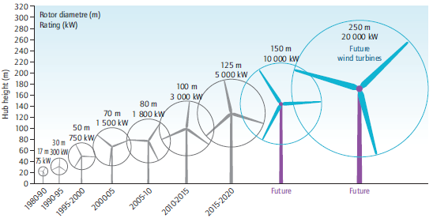


Challenges of wind turbine
Source: DOE
Increasing turbine size
More frequent maintenance
Time-varying wind speed
The plant dynamics are varying
Control Goals
Decrease the fluctuations of the generator speed and output power in time-varying wind speed
Mitigate the structural fatigue to decrease the maintenance cost
Notes:
There are some major challenges of wind turbine
One is the increasing turbine size: wind turbines have gotten progressively larger over the past 30 years. It can increase generation capacity and drive down costs. However, the larger size leads to more frequent maintenance.
The second is ……. We should design control laws to increase power capture at varying wind field.

Slide 5
Outline
Background
Research Objective
Approach
Case Analysis
Concluding Remarks

Slide 6
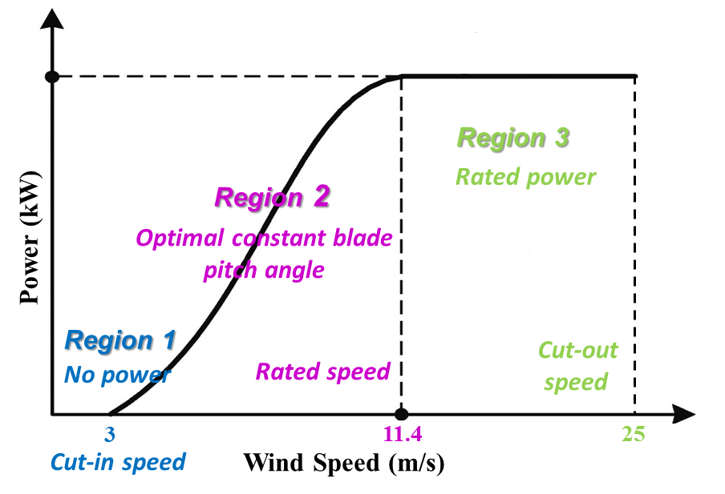
Research Objective
Overall objective: Decrease generator speed fluctuation and output power fluctuation in Region 3
Obtain the rated generator speed
Control laws
Baseline PID control ^{[1]}
Disturbance accommodating control ^{[2]}
Feedforward control ^{[3]}
Adaptive control ^{[4]}
Disturbance observer based control
[1] Jonkman et al., National Renewable Energy Laboratory Technical Report, 2009.
[2] Wright, National Renewable Energy Laboratory Technical Report, 2004.
[3] Wang et al., IEEE Transactions on Control Systems Technology, 2012.
[4] Frost et al., International Journal of Robust and Nonlinear Control, 2009.
Notes:
Wind operating conditions are traditionally divided into 3 regions
This figure shows the operating regions…
In Region 1, the wind speed is very low, turbine did not start, there is no power.
In Region 2, Blade pitch angle is held optimal constant.
In Region 3 we want the generator power is held at a constant value.
Specifically, what we want to achieve is ….in region 3…. In this research, we propose the disturbance observer based controller to achieve this goal. And compare it with the
DAC cancel out the disturabnce by eliminating the coeffciate of disturbance state
Feedfprward control employs a wind speed sensor , LIDAR to neasure wind speed can cancel out it in feedfowrad loop.
Ada.. Can force the nominal output to track the ref. output without knowing the accurate model

Slide 7
Outline
Background
Research Objective
Approach
Case Analysis
Concluding Remarks

Slide 8
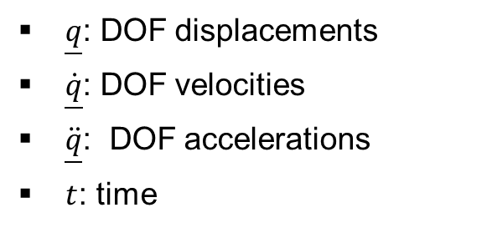
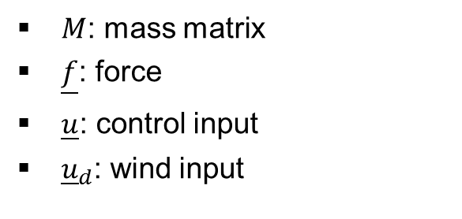
Nonlinear Aerodynamics
AeroDyn
An aero-elastic simulation code (by NREL) to predict the aerodynamics
Input: steady or turbulent wind file
Output: force and moment on the turbine components
Nonlinear aero-elastic equations of motion of wind turbine system
$M$: mass matrix
$\underline{f}$: force
$\underline{u}$: control input
${\underline{u}}_{d}$: wind input
$\underline{q}$: DOF displacements
$\underline{\dot{q}}$: DOF velocities
$\ddot{\underline{q}}$: DOF accelerations
$t$: time
Notes:
In order to get a proper model to design the controller,
we use the AeroDyn code to….. The input are wind file, turbine geometry, airfoil files and so on.
The output is force ……
The nonlinear …..is in this from. q .. F.. U.. Ud..
M is mass matrix, it is related to q, u, t that is because of different coordinates we use.
//which is independent, wind speed, pitch angle
which is not: rotor speed

Slide 9
Model Linearization
FAST (Fatigue, Aerodynamics, Structures, Turbulence)
FAST code (by NREL) used for simulating the coupled dynamic responses of wind turbines
State space representation
Numerically linearize the equation by perturbing (∆) each variable about their respective operating points (op):
linearization
Notes:
Then we can link it to FAST code to do linearization
FAST numerically …and substituting it to the previous nonlinear equation of motion
after Taylor series expansion. We could get the standard linearized form
And this is the state space form, delta ud is disturbance from the wind speed at operating point
So we have got the linearized model
(DspCis the displacement output matrix VelCis the velocity output matrix)

Slide 10
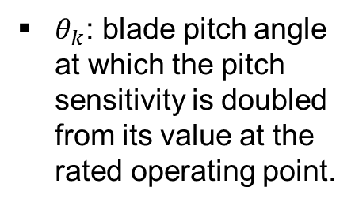
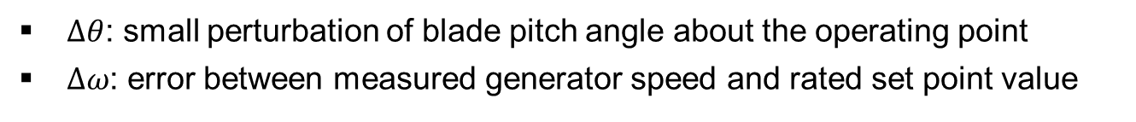
Baseline Pitch Control
Baseline Gain Scheduling Proportional Integral Derivative pitch controller ^{[1]}
$∆θ$: small perturbation of blade pitch angle about the operating point
$∆ω$: error between measured generator speed and rated set point value
Gain scheduling factor to accommodate time-varying operating wind condition
$θ_{k}$: blade pitch angle at which the pitch sensitivity is doubled from its value at the rated operating point.
Gain scheduling: $K_{p }{,K}_{I}$, $K_{D}$ are changed
[1] Jonkman et al., National Renewable Energy Laboratory Technical Report, 2009.
.
Notes:
Now let’s move to the baseline pitch control
Different from the classical PID control, we add a gain scheduled factor to …. part which is a function of pitch angle.
That is the gs part, we can change the PID gains when wind speed is varying. Because PID gains are tuned at Op, which can not gurantee the perfect performance at time-varying wind field.
After the PID gains, we also add the mechanical limits of pitch actuator in the block..
(Pitch actuator: 30HZ)

Slide 11
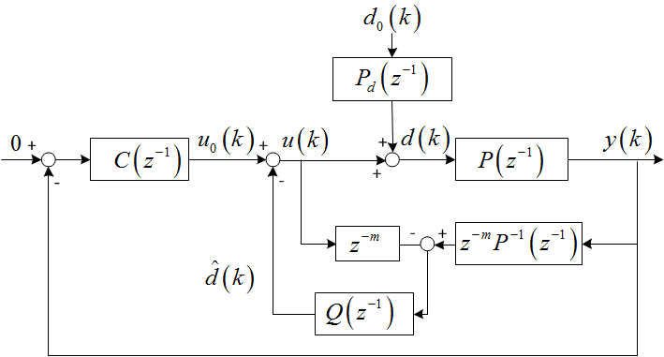
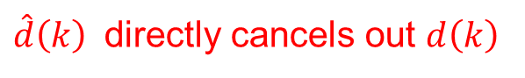
Disturbance observer based controller
$d_{0}\left(k\right)$:
wind disturbance
$P_{d}\left(z^{−1}\right)$:
disturbance model
$P\left(z^{−1}\right)$:
plant model
$P^{−1}\left(z^{−1}\right)$:
model inversion
$Q\left(z^{−1}\right)$:
filter
$C\left(z^{−1}\right)$:
PID controller
Why this controller?
PID controller: gains are tuned in rated wind, but time-varying wind speed
Gain-scheduling PID: perfect gain correction is not strictly guaranteed
Augmented controller: inner-loop can further reject low frequency disturbance based on the disturbance suppression of the outer-loop.
den
num
$\hat{d}\left(k\right)$ directly cancels out $d\left(k\right)$
0
filter Q
Notes:
Now let’s move to the disturbance obersver….
It is an inverse-based disturbance cancelation scheme. We want to use d hat to directly cancel out d
The inner loop is the disturbance observer structure, the outter loop is the gain-scheduled PID controller. Both of them will contribute to disturbance rejection.
The P inverse should be stable
For any signal d it will satisfy this eq. where Bd is numerator of atransofrm of d. Ad is the corsponding den.

Slide 12
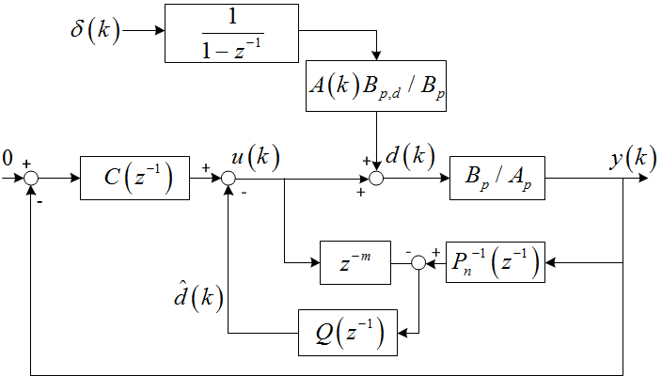
Disturbance Observer based controller
Persistent wind disturbance input:
unknown amplitude, known waveform
step disturbance
Wind disturbance: Variance between nominal wind speed and the operating wind speed
Notes:
We assume in this reseach, dot
Take z transform of step. And from the loop shaping of previuos control sheckem,
So under the step disturbance, we can derive the expression of d

Slide 13
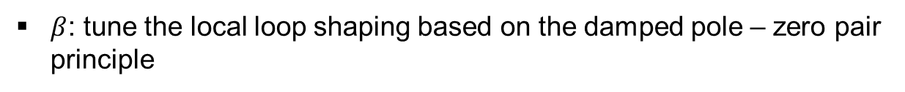
Disturbance Observer based controller
Step disturbance goes through disturbance model
Disturbance rejection is achieved if
0
: FIR filter, ensure causality of Q filter
$β$: tune the local loop shaping based on the damped pole – zero pair principle
Notes:
The FIR filter K is added to ensure the causality of Q
We also introduce an extra item in the denominator, where the design of belta is used to tune the local loop shaping. based on the damped pole –zero pair pinciple.
The effect of the choice of belta will be explained in details later.
When there is no belta, the shape of Q is certain ,we can not tune it. Belta can change the shape of Q, then we can tune it. Look at the figure.

Slide 14
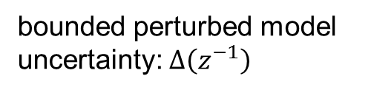
Stability and Robustness
No mismatch
between actual model and nominal model
Mismatch
bounded perturbed model uncertainty: $∆\left(z^{−1}\right)$
Stability Robustness ^{[5]}
[5] Doyle et al., Feedback Control Theory, 1990.
Notes:
Previously we mentioned that the new controller is an augmented controller, will it still be stable and have perfect tracking of the reference signal?
This figure is an equivalent structure of the original controller.
The uncertainty can be bounded as
Based on the robust control theory, we can derive the condition for stability roubustness
This criteria can guide us designing the Q filter

Slide 15
Outline
Background
Research Objective
Approach
Case Analysis
Concluding Remarks
Notes:
Next we will present the case study results

Slide 16
5-DOF linearized model
5 DOF: Generator DOF, drivetrain torsional flexiblity DOF, and first flapwise blade mode DOF (three blades)
Notes:
To obtain the preliminary result of the DOB controller, we first apply the controller into the 5-DOF linearized model
These are the
The result seems to be promising, so how is it with the nonlinear plant

Slide 17
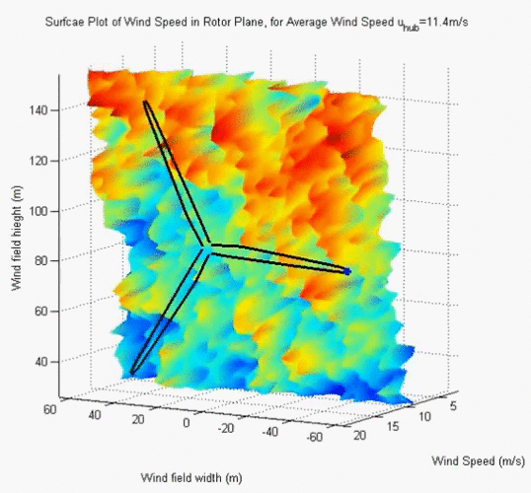
Case Study: Nonlinear plant
Case study:
Test wind turbine
NREL offshore 5-MW baseline
wind turbine
Degree of freedom (DOF)
16 DOFs*
Turbulent wind field
Simulation time
Run time: 0 to 600 s
Integration step size: 0.0125 s
Blade pitch limit and pitch rate limit ^{[1]}
Minimum/maximum blade pitch: 0 degree / 90 degree
Maximum absolute blade pitch rate: 8 degree/s
Source:https://www.youtube.com/watch?v=h4KidjcDDis
[1] Jonkman et al., 2009, National Renewable Energy Laboratory, Golden, CO.
*First flapwise blade mode (3 blades), second flapwise blade mode (3 blades), first edgewise blade mode (3 blades), drivetrain rotational-flexibility, generator, yaw, first fore-aft tower bending-mode, second fore-aft tower bending-mode, first side-to-side tower bending-mode, second side-to-side tower bending-mode.
Notes:
The wind speed on each segment of blade is going to change with time.

Slide 18
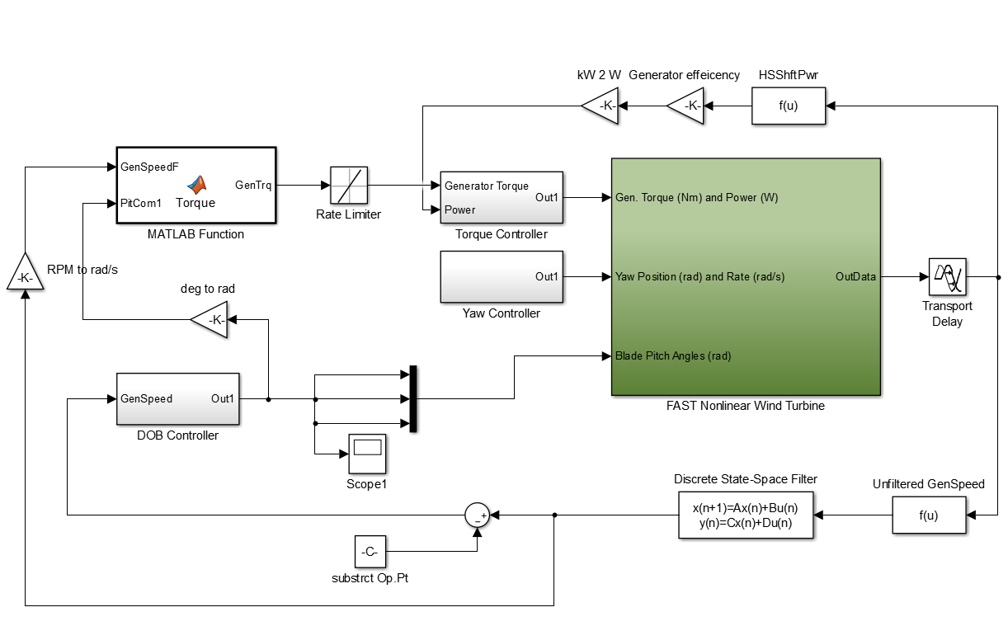
Nonlinear plant model

Slide 19

Trade-off in selection of Q filter
Trade-off between disturbance rejection region and disturbance amplification region:
Disturbance amplification:
Instability of the nonlinear plant (model mismatch exists)^{[5]}
Sensitivity function:
under different
[5] Doyle et al., Feedback Control Theory, 1990.
Notes:
Here we will talk about how to make a trade off in selection of Q filter. Specifically it is the trade-off between ……
In practice, when DOB controller is applied to nonlinear controller, the disturbance amplification at high freuqencies will lead to the insatiability of …..
Actually the value of belta is related to sensitivity function. This equation in the red box is an indicator of sensitivity function. We check the fre response of it under differernt belta.
From the figure we can see the samller belta will lead to wider disturbance rejection region, but at the same time the larger disturbance amplification. Which will influence the stability of system.
Finally we choose belta =.997.

Slide 20
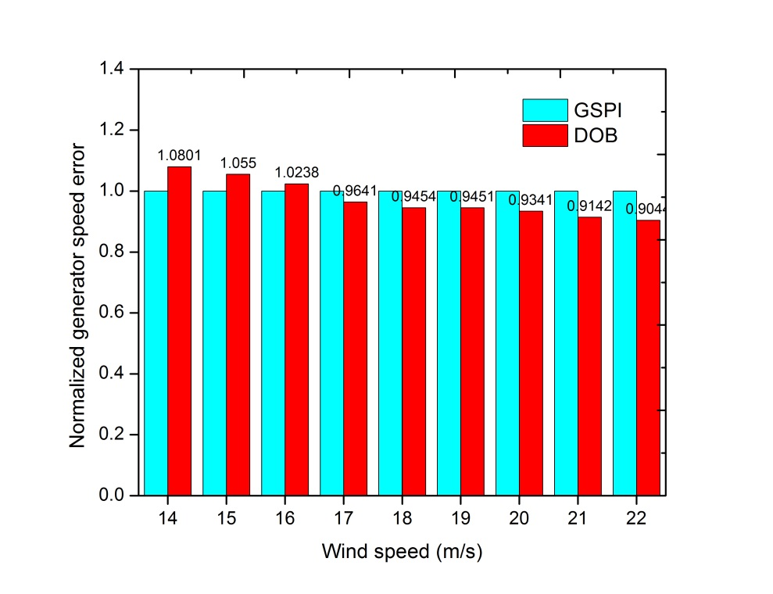
Performance comparison
Results:
3.59% - 9.56% decrease in 6 wind fields
2.38% - 8.01% increase in 3 wind fields
Limited performance due to trade-off with respect to the stability issue
Notes:
This slide shows the results based on the selected Q filter
The first figure is wind speed
The second figure is the …response under 18
We can see
To test robustness of the DOB controller, we applied it to wide wind speed region from 14 to 22.
We can find there is …..
So what more we can do?

Slide 21
Add-on compensator
Faster roll-off at high frequencies
Low pass filter
Q filter (DOB)
Q* filter (DOB*)
Smaller disturbance amplification at certain high frequencies in Q*
Better disturbance rejection in low freq.
Sensitivity function
Notes:
Next we will introduce how to improve the tracking perfromance. We propose to use an add-on compes

Slide 22
Performance comparison
FFT

Slide 23
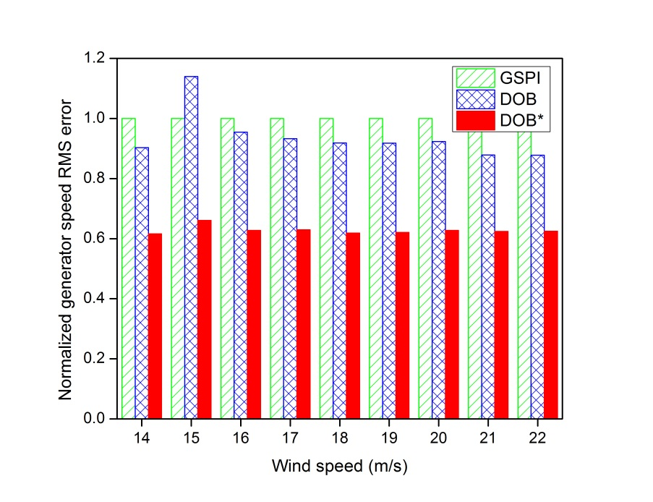
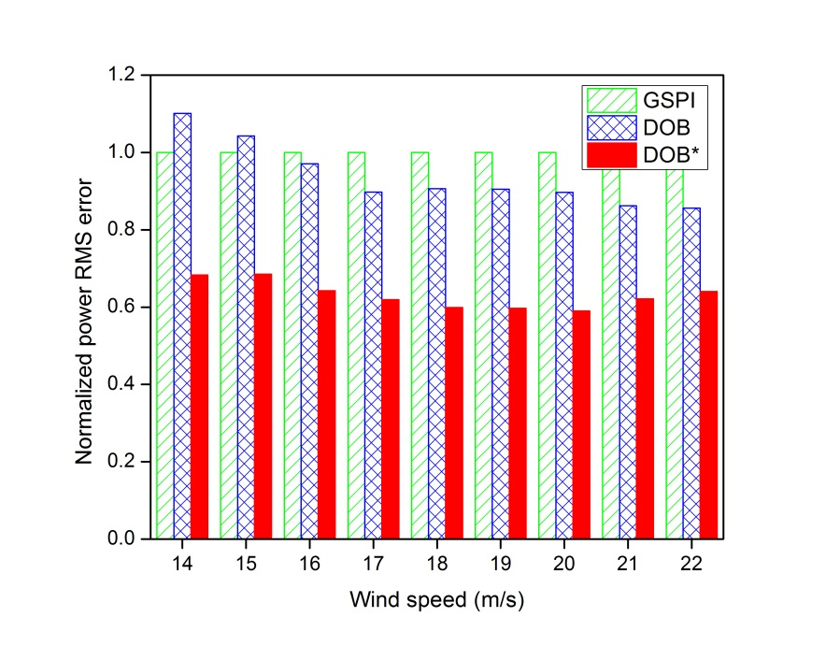
Performance comparison
Normalized generator speed RMS error: -28.13% to -39.14%
Normalized power RMS error: -31.43% to -40.93%
Conclusion:
Enhanced generator speed and power regulation with DOB* in Region 3
Notes:
We can obtain an obvious decrease

Slide 24
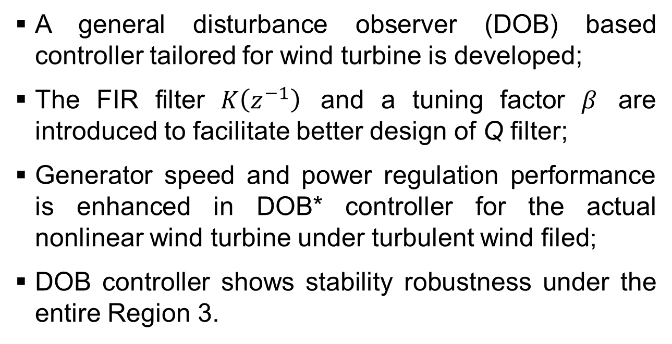
Concluding Remarks
A general disturbance observer (DOB) based controller tailored for wind turbine is developed;
The FIR filter $K\left(z^{−1}\right)$ and a tuning factor $β$ are introduced to facilitate better design of Q filter;
Generator speed and power regulation performance is enhanced in DOB* controller for the actual nonlinear wind turbine under turbulent wind filed;
DOB controller shows stability robustness under the entire Region 3.
This research is supported by NSF under grant CMMI – 1300236
Notes:
simulation software

Slide 25
The End
Questions?
Notes:
Thank you

Slide 26
References
[1] Jonkman et al., Definition of a 5-MW reference wind turbine for offshore system development. 2009: National Renewable Energy Laboratory Golden, CO.
[2] Wright, Modern control design for flexible wind turbines. 2004: National Renewable Energy Laboratory Golden, CO, USA.
[3] Wang, Johnson and Wright. (2012). FX-RLS-based feedforward control for LIDAR-enabled wind turbine load mitigation. Control Systems Technology, IEEE Transactions on, 20(5), 1212-1222.
[4] Frost, Balas, and Wright. Adaptive Control of a Utility-Scale Wind Turbine Operating in Region 3. Proceedings of the 28th AIAA Aerospace Sciences Meeting and Exhibit Wind Energy Symposium. 2009.
[5] Chen and Tomizuka. An enhanced repetitive control algorithm using the structure of disturbance observer. Advanced Intelligent Mechatronics (AIM), 2012 IEEE/ASME International Conference on. IEEE, 2012.

Slide 27
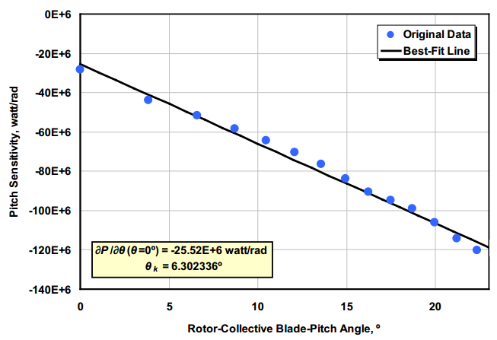
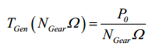
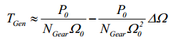
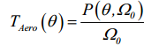
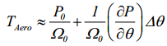
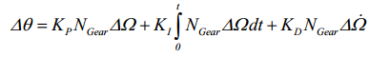
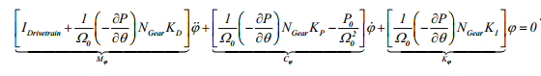
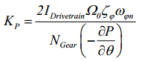
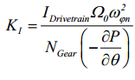
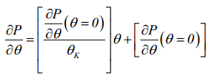
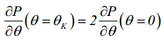
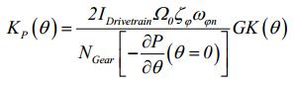
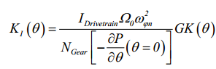
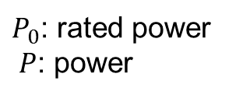
Gain Scheduling PID
$P_{0}$: rated power
$P$: power

Slide 28
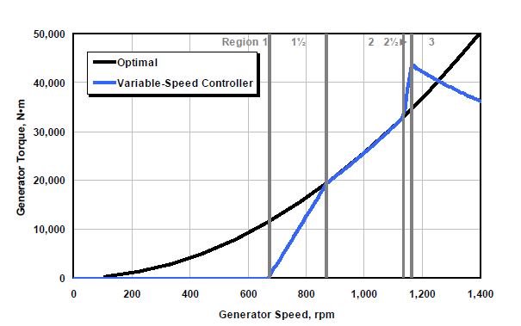
Region 2 Torque Control

Slide 29
Other results
: GSPI, : DOB*.
RMS pitch rate
Average power
Loads on drive-train, blades and tower

Slide 30
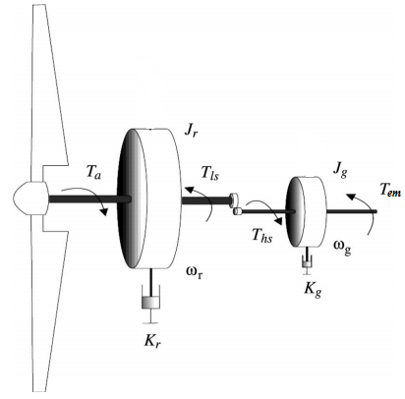
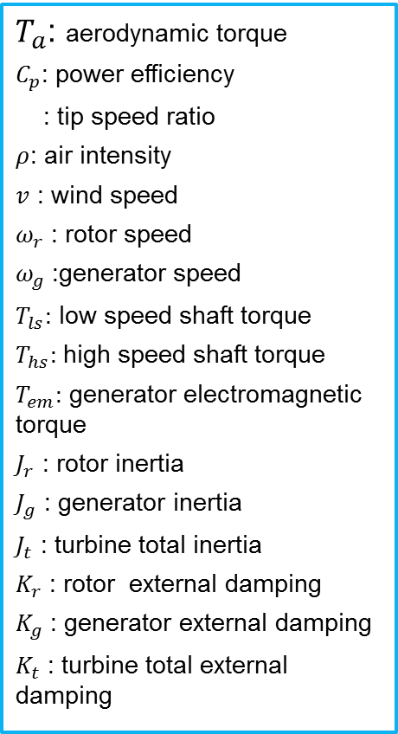
Simple Model
Aerodynamic torque
$T_{a}$: aerodynamic torque
$C_{p}$: power efficiency
: tip speed ratio
$ρ$: air intensity
$v$ : wind speed
$ω_{r}$ : rotor speed
$ω_{g}$ :generator speed
$T_{ls}:$ low speed shaft torque
$T_{hs}:$ high speed shaft torque
$T_{em}:$ generator electromagnetic torque
$J_{r}$ : rotor inertia
$J_{g}$ : generator inertia
$J_{t}$ : turbine total inertia
$K_{r}$ : rotor external damping
$K_{g}$ : generator external damping
$K_{t}$ : turbine total external damping
Rotor Dynamics and
generator dynamics
Gearbox ratio
Notes:
In most of the literature, a simple model is adopted to design control method in order to get better speed regulation.
The aerodynamics… is a function of power efficiency, wind speed and rotor speed, it is highly nonlinear.
Assume the low speed shaft is rigid, the rotor dynamics and generator dynamics can be expressed as…
As the low speed shaft torque and HSS torque satisfy gearbox ratio relationship, finally we could get a simple equation of motion.
We can control the electromagnetic torque to track the generator speed. But it is hard to use this model to adjust blade pitch angle to achieve load reduction. Because here the pitch angle is contained in the nonlinear term Cp.

Slide 31
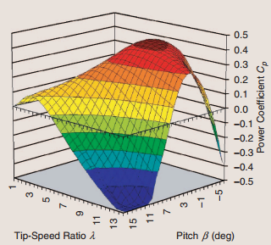
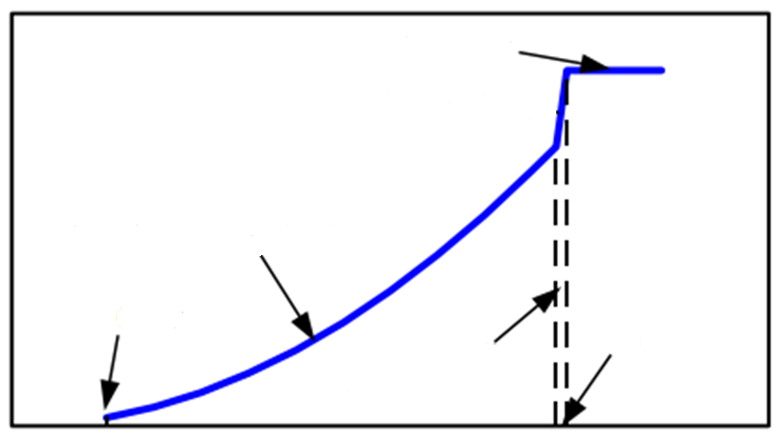

Region 2 Standard Torque Control
TSR:$λ=\frac{ωR}{v}$
Generator Torque (N*m)
Region 3
Region 2 standard torque control
Region 2
Optimal constant blade pitch angle
Region 1
Rated generator speed
No power
Region 2 1/2
Linear transition
670
1161
1173
Generator Speed (rpm)
Notes:
In Region 2, the control objective is to maximize the power capture. We use torque control to achieve it. Let us look at the Cp surface. We can see the maximum value is in pitch angle 0 tip speed ratio 7.5.
That is make the tip speed ratio be the optimal value, at the optimal pitch angle.
Then we should let the rotor speed track the wind speed. Here the pitch control is disabled, then we control torque to change rotor speed.
power Per second

Slide 32
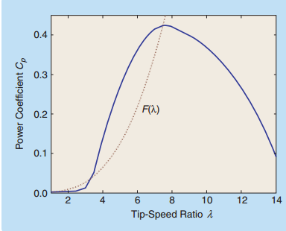

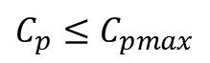
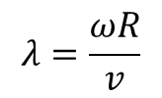

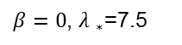
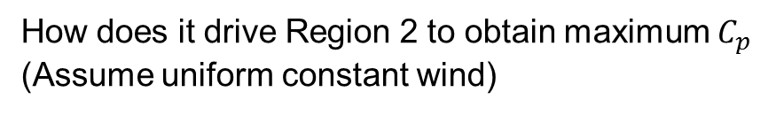
Region 2 standard torque control
$$λ=\frac{ωR}{v}$$
How does it drive Region 2 to obtain maximum $C_{p}$ (Assume uniform constant wind)
$β=0$, ${λ }_{∗}$=7.5
The curve (dotted line)
The solid line $Cp(β=0)$
$λ>{λ }_{∗}$, $\dot{ω_{r}}<0$, rotor will decelerate towards $λ={λ }_{∗}$
$C_{p}≤$ $C_{pmax}$
, , $\dot{ω_{r}>}0\text{, }λ{<λ }_{∗}$, it will accelerate to ${λ }_{∗}$
, $\dot{ω_{r}<}0$ rotor speed will slow to zero

Slide 33
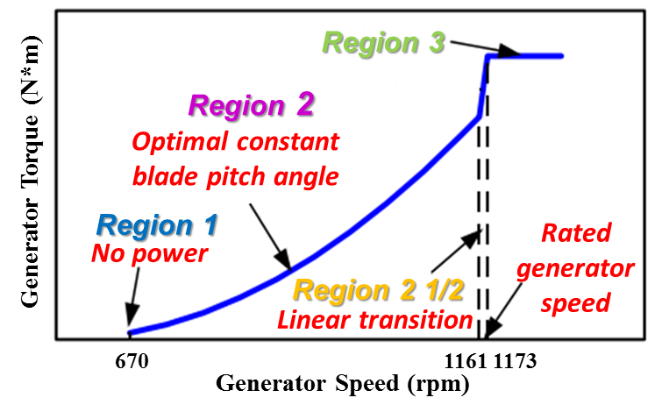
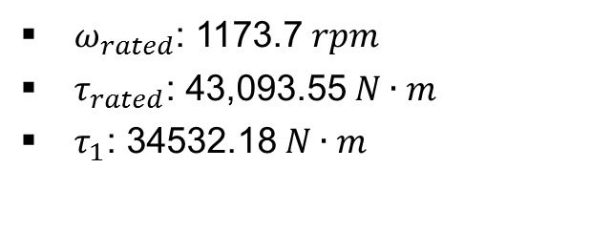
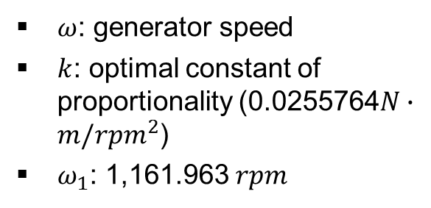
Torque Control
Generator torque controller
$ω$: generator speed
$k$: optimal constant of proportionality (0.0255764$N∙m/{rpm}^{2}$)
$ω_{1}$: 1,161.963 $rpm$
$ω_{rated}$: 1173.7 $rpm$
$τ_{rated}$: 43,093.55 $N∙m$
$τ_{1}$: 34532.18 $N∙m$
Notes:
That is the overall torque control in 3 regions…..
Actually the torque controller can be designed with adaptive control or sliding mode control to achieve better performance in the literature.
Here for this baseline controller,
In Region 1, torque is 0.
In region 2 ,torque is a function of generator speed. To maintain a constant optimal tip speed ratio
In region 2 and a half, it is a ……
In region 3 ,the torque is held at rated value

Slide 35
Basic Concepts
Disturbance can be represented by z transform
0
For disturbance satisfying
(asymptotically)
Notes:
Dk is the impulse response of this transfer function

Slide 36
Zero Phase Error Tracking method
Unstable inversed model
Plant P may have nonminimum zeros. P inverse is not stable
Zero Phase Error Tracking (ZPET) method
includes zeros of stable part, includes zeros of unstable part
Stable model inversion
Notes:
Usually in the modern commercial wind turbine,

Slide 37
Bode of PID
Notes:
What Q cut-off freq. means? Reject the disturbance smaller than this?
0.9952 . Smaller than this, it diverge

Slide 38
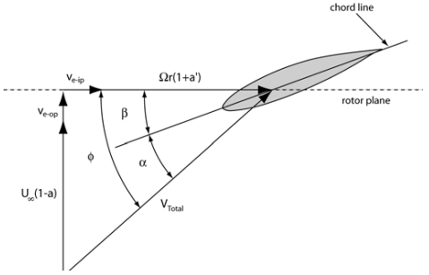
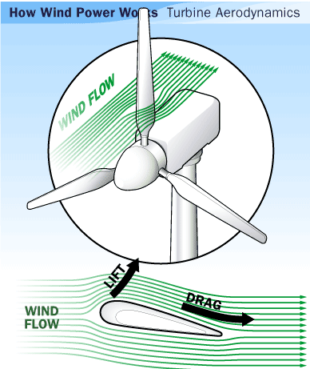
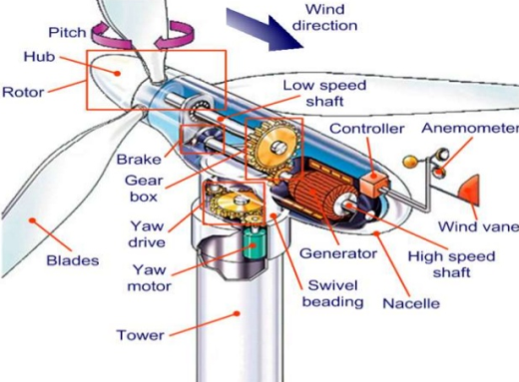
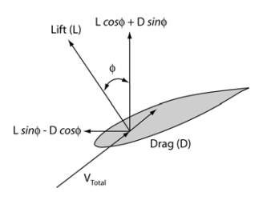
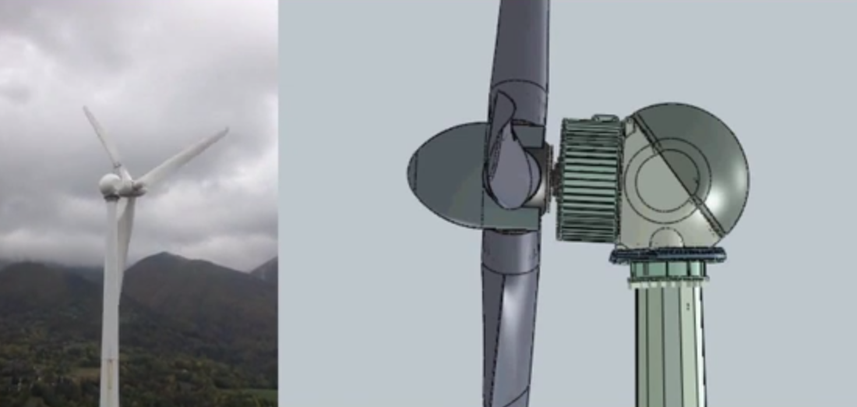
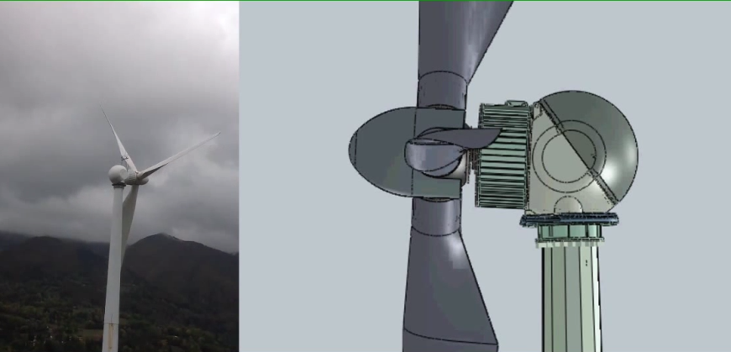


Pitch angle
Low speed shaft horizontal axis
rotor plane
Wind turbine starts($β=0$)
Wind turbine stops($β=$90)
Notes:
Pitch angle is the angle between chord line and rotor plane

Slide 39

Turbulent wind field

Slide 41


Flapwise shear force and moment
Flapwise shear force at the blade root:
Directed along the $x_{b,i}$ axis (kN)
Flapwise moment at the blade root :
About the $y_{b,i}$ axis (kN*m)
Wind
Notes:
Perpendicular
parallel

Slide 42

Pitch Sensitivity
Blade-pitch sensitivity
aerodynamic property of the rotor that depends on the wind speed, rotor speed, and blade-pitch angle
perturb the rotor collective blade pitch angle at each operating point and measure the resulting variation in aerodynamic power
Table Sensitivity of Aerodynamic Power to Blade Pitch in Region 3
Wind speed (m/s) | Rotor Speed (rpm) | Pitch Angle (deg) | $\frac{∂θ}{∂x}$ (watt/rad)
11.4-Rated | 12.1 | 0.00 | -28.24E+6
12.0 | 12.1 | 3.83 | -43.73E+6
13.0 | 12.1 | 6.60 | -51.66E+6
14.0 | 12.1 | 8.70 | -58.44E+6
15.0 | 12.1 | 10.45 | -64.44E+6
16.0 | 12.1 | 12.06 | -70.46E+6
17.0 | 12.1 | 13.54 | -76.53E+6
18.0 | 12.1 | 14.92 | -83.94E+6
19.0 | 12.1 | 16.23 | -90.71E+6
20.0 | 12.1 | 17.47 | -94.71E+6
21.0 | 12.1 | 18.70 | -99.04E+6
22.0 | 12.1 | 19.94 | -105.90E+6
23.0 | 12.1 | 21.18 | -114.30E+6
24.0 | 12.1 | 22.35 | -120.20E+6
25.0 | 12.1 | 23.47 | -125.30E+6

Slide 43

Torque control: Choose the appropriate stator current according to the difference of reference torque and actual torque
Control structure of a permanent magnet synchronous generator system for use in wind turbines
Notes:
Stator coils
Rotor magnet

Slide 44


Slide 45

Step wind from 17 m/s to 21 m/s Turbulent 18 m/s wind field

